Slide 1


Coffee sales performance dashboard
By Keval Patel
Keval Patel|LinkedIn
KevalPatel-Analyst (Keval Patel)|GitHub

Slide 2


Coffee Sales Performance Dashboard
Stakeholders
Meta Data
Tools Used
Sales Team
File Extension - .csv
Power Bi :- For creating dashboard
Marketing Team
No of Rows – 1134
Operations Manager
No of Fields - 6
Power Query :- For data cleaning and transforming data
Finance Team
Canva :- For creating Presentation

Slide 3
Coffee Sales Performance Dashboard
Business Problem
I was assigned to analyze the key factors affecting overall revenue performance for the coffee business.
The business is currently falling short of its monthly revenue target, requiring a deeper understanding of sales trends.
The goal was to explore customer purchasing behavior across weekdays vs. weekends.
I was also asked to identify which products and payment methods are contributing the most or least to revenue.
The objective is to deliver insights that help:
Improve daily sales consistency
Boost weekend revenue performance
Support strategic decisions around promotions, product focus, and operational planning.

Slide 4


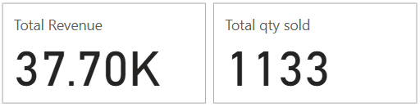


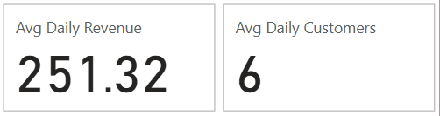
Coffee Sales Performance Dashboard
💰 Total Sales Performance
The business generated a total revenue of $37.7K from 1,133 units sold, reflecting a steady performance over the selected 5-month period.
The average daily revenue stands at $251.32, with 6 daily customers, indicating a consistent but limited customer base that could be expanded.

Slide 5
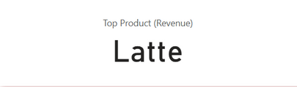

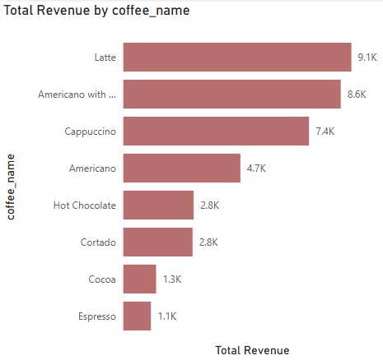
Coffee Sales Performance Dashboard
Product Performance Insights
Americano with Milk is the most ordered coffee, showing it's the most popular choice among customers
Latte brings in the highest revenue ($9.1K), likely due to a higher price or better margin.
Cappuccino also performs well in both revenue and demand, making it a strong third option
Espresso and Cocoa have the lowest revenue, suggesting low customer interest — consider reviewing or promoting them differently.
Focus on Latte for profit and Americano with Milk for volume-based strategies

Slide 6


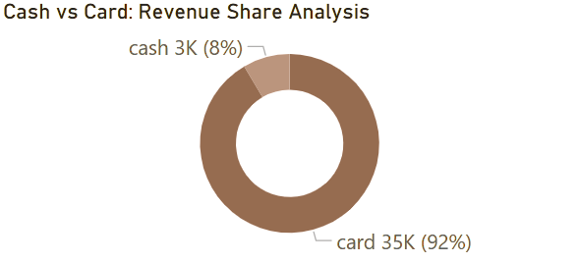
Coffee Sales Performance Dashboard
💳 Payment Trends
A significant 92% of sales come through card payments, while only 8% is paid in cash.
This shows that most customers prefer using cards, which means they are comfortable with technology. It’s a good chance to offer loyalty programs, mobile apps, or card-only deals to make operations easier.

Slide 7
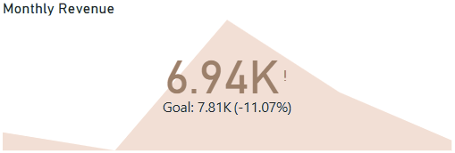
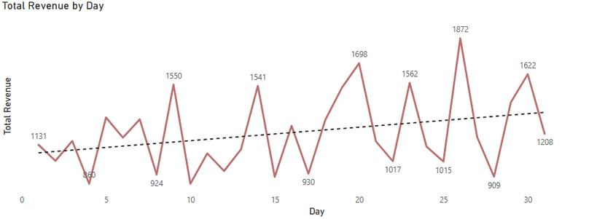
Coffee Sales Performance Dashboard
📈 Monthly and Daily Revenue Trends
The monthly revenue is $6.94K, which is 11.07% below the target of $7.81K.
Revenue on the highest-performing days reaches up to $1,872 (Day 25), followed by $1,698 (Day 20) and $1,622 (Day 29), indicating strong sales spikes.
On the lower end, days like Day 3 ($860), Day 10 ($924), and Day 18 ($930) show revenue dips, highlighting inconsistent performance.
The inconsistent daily performance is the main reason for missing the target, despite strong sales on some days.
Improving consistency across all days through offers or targeted promotions can help meet future goals more reliably.

Slide 8

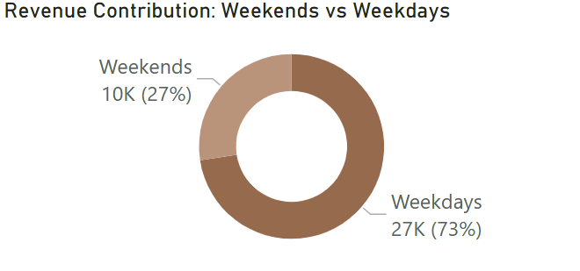
Coffee Sales Performance Dashboard
📅 Weekday vs Weekend Analysis
Weekdays generate 73% of total revenue ($27K), showing strong performance on working days.
Weekends contribute only 27% of revenue ($10K), indicating lower customer activity.
Customers likely buy more coffee during work routines or office hours.
There’s an opportunity to boost weekend sales through:
Weekend-only discounts or offers
targeted promotions on Saturdays and Sundays.
Family or group combo deals.

Slide 9
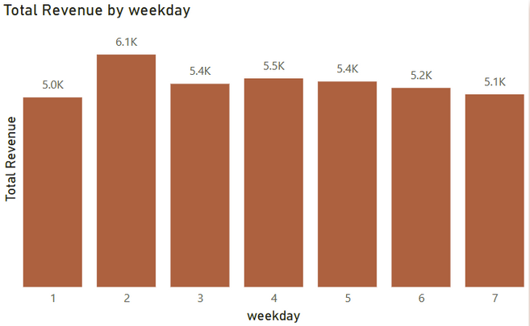
Coffee Sales Performance Dashboard
📊 Revenue by Weekday
Tuesday (Day 2) is the best-performing day with $6.1K in revenue.
Revenue remains consistently strong from Tuesday to Friday, ranging between $5.4K–$5.5K.
Monday has the lowest revenue at $5.0K, possibly due to slow starts after the weekend.
Weekends (Saturday & Sunday) show a slight dip in sales ($5.2K and $5.1K), supporting the earlier insight that weekdays outperform weekends.
Focus marketing on Monday (to boost slow starts) and weekends (to balance sales) — using coffee combos, loyalty points, or “weekend specials.”

Slide 10
Thankyou
By Keval Patel
Keval Patel|LinkedIn
KevalPatel-Analyst (Keval Patel)|GitHub

